Slide 1
ANALYSIS FRAMEWORK

Slide 2
Analysis of Algorithms
What is the goal of analysis of algorithms?
What do we mean by running time analysis?
2

Slide 3
Analysis of Algorithms
What is the goal of analysis of algorithms?
To estimate how long a program will run.
To estimate the largest input that can reasonably be given to the program.
To compare the efficiency of different algorithms.
To help focus on the parts of code that are executed the largest number of times.
To choose an algorithm for an application.

Slide 4
Analysis of Algorithms
An algorithm is a finite set of precise instructions for performing a computation or for solving a problem.
What is the goal of analysis of algorithms?
  To compare algorithms mainly in terms of running time but also in terms of other factors (e.g., memory requirements, programmer's effort etc.)
What do we mean by running time analysis?
  Determine how running time increases as the size of the problem increases.

Slide 5
Input Size
Input size (number of elements in the input)
  size of an array
  polynomial degree
  # of elements in a matrix
  # of bits in the binary representation of the input
  vertices and edges in a graph

Slide 6
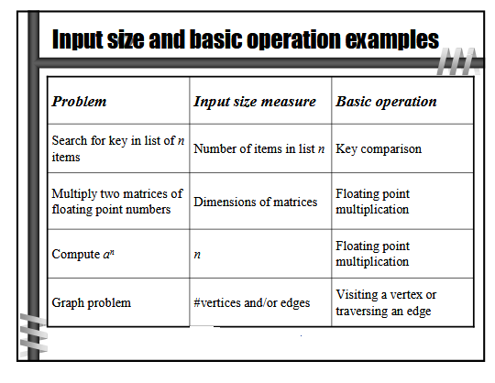

Slide 7
Types of Analysis
Worst case:
  Provides an upper bound on running time
  An absolute guarantee that the algorithm would not run longer, no matter what the inputs are
Best case
  Provides a lower bound on running time
  Input is the one for which the algorithm runs the fastest
Average case
  Provides a prediction about the running time
  Assumes that the input is random

Slide 8
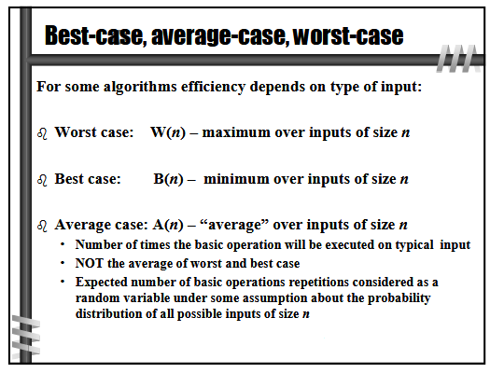

Slide 9
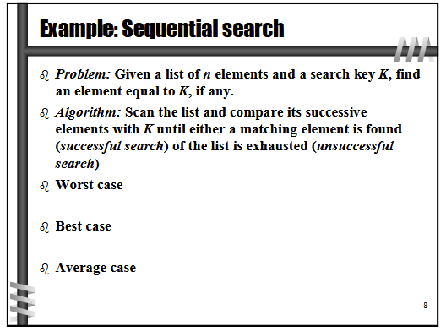

Slide 10
How do we compare algorithms?
We need to define a number of objective measures.
(1) Compare execution times?
Not good: times are specific to a particular computer !!
(2) Count the number of statements executed?
Not good: number of statements vary with the programming language as well as the style of the individual programmer.

Slide 11
Ideal Solution
Express running time as a function of the input size n (i.e., f(n)).
Compare different functions corresponding to running times.
Such an analysis is independent of CPU time, programming style, main memory, Specialized hardware, Operating system, Programming language)

Slide 12
Example
Associate a "cost" with each statement.
Find the "total cost“ by finding the total number of times each statement is executed.
Algorithm 1 Algorithm 2
Cost Cost
arr[0] = 0; c₁ for(i=0; i<N; i++) c₂
arr[1] = 0; c₁ arr[i] = 0; c₁
arr[2] = 0; c₁
... ...
arr[N-1] = 0; c₁
----------- -------------
c₁+c₁+...+c₁ = c₁ x N (N+1) x c₂ + N x c₁ =
(c₂ + c₁) x N + c₂

Slide 13
Another Example
Algorithm 3 Cost
sum = 0; c₁
for(i=0; i<N; i++) c₂
for(j=0; j<N; j++) c₂
sum += arr[i][j]; c₃
------------
c₁ + c₂ x (N+1) + c₂ x N x (N+1) + c₃ x N²

Slide 14
Asymptotic Analysis
To compare two algorithms with running times f(n) and g(n), we need a rough measure that characterizes how fast each function grows.
Hint: use rate of growth
Compare functions asymptotically! (i.e., for large values of n)

Slide 15
Growth of Functions and Asymptotic Notation
When we study algorithms, we are interested in
  characterizing them according to their efficiency.
  order of growth of the running time of an algorithm, not in the exact running time.
  This is also referred to as the asymptotic running time.
We need to develop a way to talk about rate of growth of functions so that we can compare algorithms.
Asymptotic notation gives us a method for classifying functions according to their rate of growth.

Slide 16
Rate of Growth
Consider the example of buying elephants and goldfish:
Cost: cost_of_elephants + cost_of_goldfish
~ cost_of_elephants (approximation)
The low order terms in a function are relatively insignificant for large n
n⁴ + 100n² + 10n + 50 ~ n⁴
i.e., we say that n⁴ + 100n² + 10n + 50 and n⁴ have the same rate of growth

Slide 17
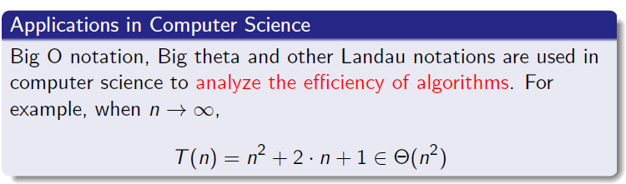
Asymptotic Analysis

Slide 18
Asymptotic Complexity
Running time of an algorithm as a function of input size n [ for large values of n]
Expressed using only the highest-order term in the expression for the exact running time.
Describes behavior of function in the limit.
Written using Asymptotic Notation
  BIG Oh Notation (O)
  BIG Omega Notation(Ω)
  BIG Theta Notation (Θ)

Slide 19
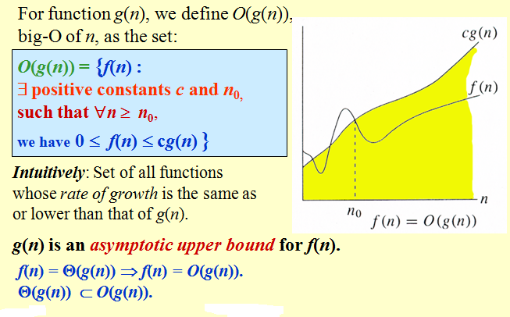
Big O -notation

Slide 20
Example
Show that 30n+8 is O(n).
  Show ∃c,n₀: 30n+8 ≤ cn, ∀n>n₀
    Let c=31, n₀=8.
    Assume n>n₀=8.
    Then
    cn = 31n = 30n + n > 30n+8, so 30n+8 < cn.

Slide 21
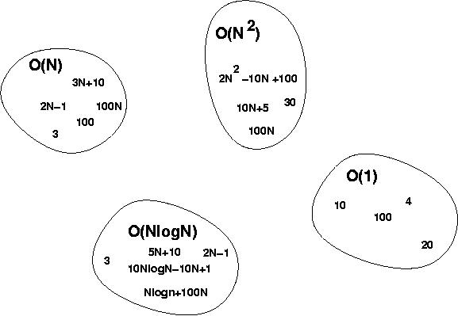
Big-O Visualization
f(n) is the set of functions with smaller or same order of growth as g(n)

Slide 22
No Uniqueness
There is no unique set of values for n₀ and c in proving the asymptotic bounds
Prove that 100n + 5 = O(n²)
  100n + 5 ≤ 100n + n = 101n ≤ 101n²
  for all n ≥ 5
  n₀ = 5 and c = 101 is a solution
  100n + 5 ≤ 100n + 5n = 105n ≤ 105n²
  for all n ≥ 1
  n₀ = 1 and c = 105 is also a solution
  Must find SOME constants c and n₀ that satisfy the asymptotic notation relation

Slide 23
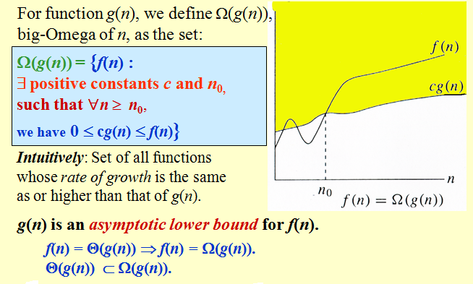
BIG Omega Notation(Ω)

Slide 24
Examples
  5n² = Ω(n)
  100n + 5 ≠ Ω(n²)
  n = Ω(2n), n³ = Ω(n²), n = Ω(logn)
  ∃ c, n₀ such that: 0 ≤ cn ≤ 5n²
⇒ cn ≤ 5n²
⇒ c = 1 and n₀ = 1
∃ c, n₀ such that: 0 ≤ cn² ≤ 100n + 5
100n + 5 ≤ 100n + 5n (∀ n ≥ 1) = 105n
cn² ≤ 105n
⇒ n(cn – 105) ≤ 0
Since n is positive ⇒ cn – 105 ≤ 0
⇒ n ≤ 105/c
⇒ contradiction: n cannot be smaller than a constant

Slide 25
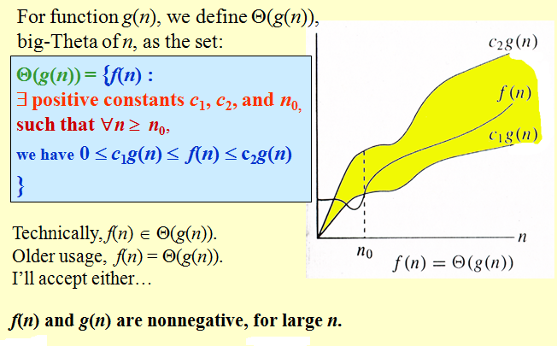
BIG Theta Notation (Θ)

Slide 26
Examples
  n²/2 –n/2 = Θ(n²)
    ½ n² - ½ n ≤ ½ n² ∀n ≥ 0 ⇒ c₂= ½
    ½ n² - ½ n ≥ ½ n² - ½ n * ½ n ( ∀n ≥ 2 ) = ¼ n² ⇒ c₁= ¼
  n ≠ Θ(n²): c₁ n² ≤ n ≤ c₂ n²
  ⇒ only holds for: n ≤ 1/c₁

Slide 27
Big-O example, graphically
Note 30n+8 isn’t less than n anywhere (n>0).
It isn’t even less than 31n everywhere.
But it is less than
31n everywhere to
the right of n=8.
cn =
31n
30n+8
30n+8
∈O(n)
Value of function →
n
n>n₀=8 →
Increasing n →

Slide 28
Asymptotic Notation
O notation: asymptotic “less than”:
  f(n)=O(g(n)) implies: f(n) “≤” g(n)
Ω notation: asymptotic “greater than”:
  f(n)= Ω (g(n)) implies: f(n) “≥” g(n)
Θ notation: asymptotic “equality”:
  f(n)= Θ (g(n)) implies: f(n) “=” g(n)

Slide 29



Relations Between Θ, O, Ω

Slide 30
More Examples …
n⁴ + 100n² + 10n + 50 is O(n⁴)
10n³ + 2n² is O(n³)
n³ - n² is O(n³)
constants
  10 is O(1)
  1273 is O(1)

Slide 31
Back to Our Example
Algorithm 1 Algorithm 2
Cost Cost
arr[0] = 0; c₁ for(i=0; i<N; i++) c₂
arr[1] = 0; c₁ arr[i] = 0; c₁
arr[2] = 0; c₁
...
arr[N-1] = 0; c₁
----------- -------------
c₁+c₁+...+c₁ = c₁ x N (N+1) x c₂ + N x c₁ =
(c₂ + c₁) x N + c₂
Both algorithms are of the same order: O(N)

Slide 32
Exercise
Rank the following functions by asymptotic growth rate in non-decreasing order:

Slide 33

Exercise Answer
Rank the following functions by asymptotic growth rate in non-decreasing order:

Slide 34
Example (cont’d)
Algorithm 3 Cost
sum = 0; c₁
for(i=0; i<N; i++) c₂
for(j=0; j<N; j++) c₂
sum += arr[i][j]; c₃
------------
c₁ + c₂ x (N+1) + c₂ x N x (N+1) + c₃ x N² = O(N²)

Slide 35
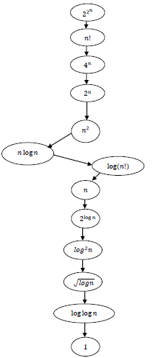
Order of Growth

Slide 36
More Examples
For each of the following pairs of functions, either f(n) is O(g(n)), f(n) is Ω(g(n)), or f(n) = Θ(g(n)). Determine which relationship is correct.
  f(n) = log n²; g(n) = log n + 5
  f(n) = n; g(n) = log n²
  f(n) = log log n; g(n) = log n
  f(n) = n; g(n) = log² n
  f(n) = n log n + n; g(n) = log n
  f(n) = 10; g(n) = log 10
  f(n) = 2^{n}; g(n) = 10n²
  f(n) = 2^{n}; g(n) = 3^{n}
f(n) = Θ (g(n))
f(n) = Ω(g(n))
f(n) = O(g(n))
f(n) = Ω(g(n))
f(n) = Ω(g(n))
f(n) = Θ(g(n))
f(n) = Ω(g(n))
f(n) = O(g(n))

Slide 37
Properties
Theorem:
f(n) = Θ(g(n)) ⇔ f = O(g(n)) and f = Ω(g(n))
Transitivity:
  f(n) = Θ(g(n)) and g(n) = Θ(h(n)) ⇒ f(n) = Θ(h(n))
  Same for O and Ω
Reflexivity:
  f(n) = Θ(f(n))
  Same for O and Ω
Symmetry:
  f(n) = Θ(g(n)) if and only if g(n) = Θ(f(n))
Transpose symmetry:
  f(n) = O(g(n)) if and only if g(n) = Ω(f(n))

Slide 38
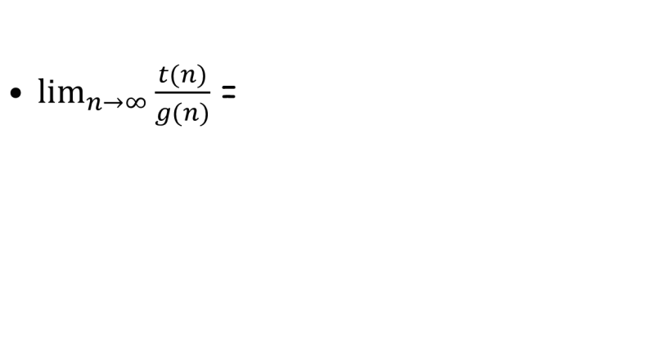
Using Limits for Comparing Orders of Growth
0 implies that t(n) grows slower than g(n)
c implies that t(n) grows at the same order
as g(n)
∞ implies that t(n) grows faster than g(n)
1. First two cases (0 and c) means t(n) є O(g(n))
2. Last two cases (c and ∞) means t(n) є Ω(g(n))
3. The second case (c) means t(n) є Θ(g(n))

Slide 39
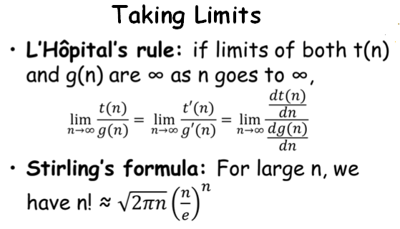
Using Limits for Comparing Orders of Growth

Slide 40
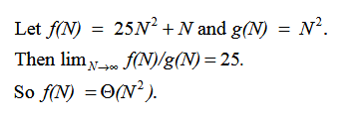
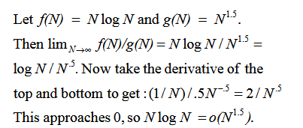
Example
Eg1:
Eg 2:

Slide 41



Relatives of Big-O
Small ‘o’ Notation: For every c and n if f(n) is always less than g(n) then f(n) belongs to o(g(n)).
Small Omega Notation: For every c and n if f(n) is always above than g(n) then f(n) belongs to small omega(g(n)).

Slide 42
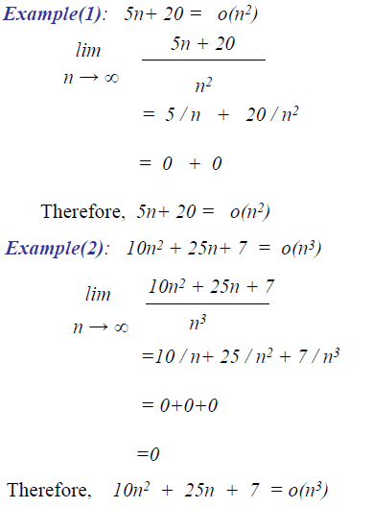
Small-O Examples

Slide 43
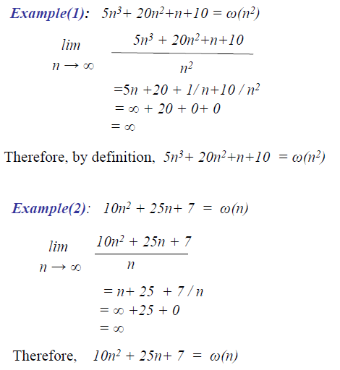
Small-Ω

Slide 44
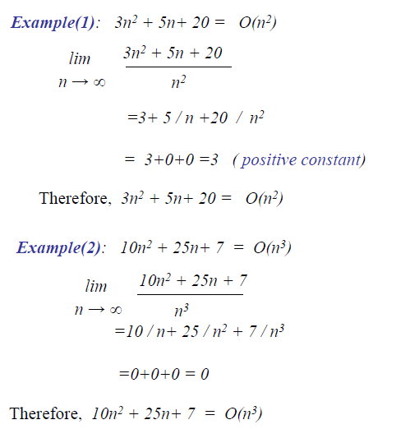
Big-O

Slide 45
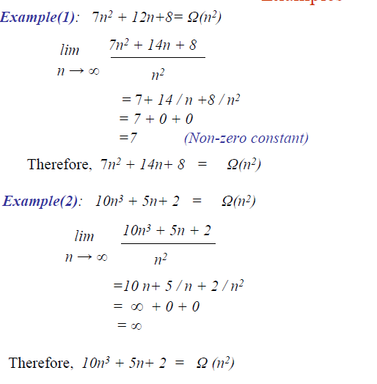
Big-Ω

Slide 46
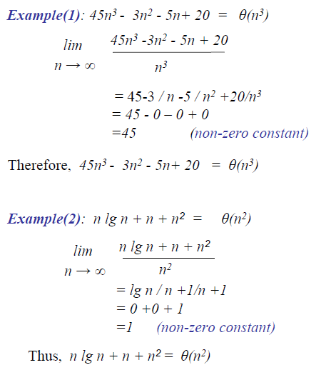
Θ Examples

Slide 47
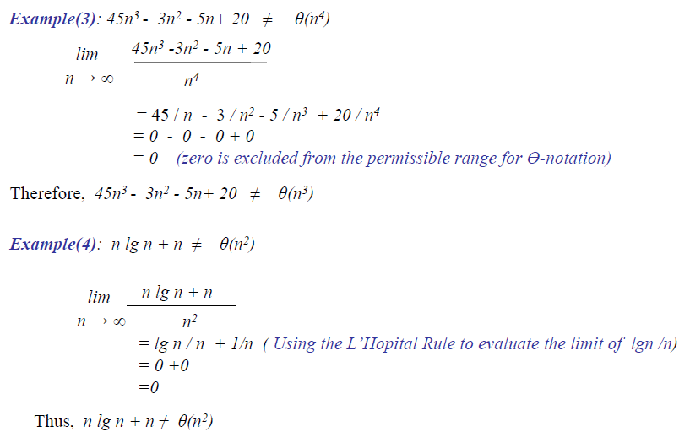
Θ Examples

